Slide 1
INTRO to DATA SCIENCE networks & graphs

Slide 2
i. networks ii. Network statics iii. Network dynamics
agenda

Slide 3
I. networks
INTRO TO DATA SCIENCE

Slide 4
Networks
Q: What is a network?
A: A set of pairwise relationships between objects.
Notes:
Discussion will be general, but the real object of interest is the “social network”

Slide 5
Networks
Q: What is a network?
A: A set of pairwise relationships between objects.
The ubiquity of social networks gives rise to many interesting data-oriented questions that can be answered with analytical techniques.
Notes:
Discussion will be general, but the real object of interest is the “social network”

Slide 6
Networks
Q: What is a network?
A: A set of pairwise relationships between objects.
The ubiquity of social networks gives rise to many interesting data-oriented questions that can be answered with analytical techniques.
Given a large set of social network data, what types of questions do you think would be interesting to ask?
Notes:
Discussion will be general, but the real object of interest is the “social network”

Slide 7
Networks
Some natural questions arise when considering social network data, in particular:

Slide 8
Networks
Some natural questions arise when considering social network data, in particular:
- What is the mathematical language for considering network
problems?
- What kinds of data structures are well-suited to network analysis?
- What does the network look like?

Slide 9
Networks
Some natural questions arise when considering social network data, in particular:
- What is the mathematical language for considering network
problems?
- What kinds of data structures are well-suited to network analysis?
- What does the network look like?
These are questions about network representation.

Slide 10
Networks
Some natural questions arise when considering social network data, in particular:

Slide 11
Networks
Some natural questions arise when considering social network data,
in particular:
- Who are the most central and/or influential actors in a network?
- Can the network be decomposed into coherent smaller groups?
- Are any of these groups vital to the functioning of the network?
- How does this network compare to other networks?
Notes:
Note: especially for last point, the structure/behavior distinction is a fuzzy one (eg degree distrs)

Slide 12
Networks
Some natural questions arise when considering social network data,
in particular:
- Who are the most central and/or influential actors in a network?
- Can the network be decomposed into coherent smaller groups?
- Are any of these groups vital to the functioning of the network?
- How does this network compare to other networks?
These are questions about network structure.
Notes:
Note: especially for last point, the structure/behavior distinction is a fuzzy one (eg degree distrs)

Slide 13
Networks
Some natural questions arise when considering social network data, in particular:

Slide 14
Networks
Some natural questions arise when considering social network data,
in particular:
- How is information propagated through a network?
- How does a network acquire or lose members?
- How does the structure of the network evolve through time?
- How do external events affect the network?

Slide 15
Networks
Some natural questions arise when considering social network data,
in particular:
- How is information propagated through a network?
- How does a network acquire or lose members?
- How does the structure of the network evolve through time?
- How do external events affect the network?
These are questions about network behavior.

Slide 16
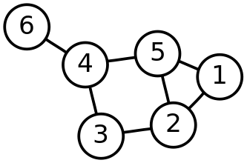
Network representation
The mathematical representation of a network is an object called a graph, which is a configuration of nodes connected by edges.
Notes:
Also vertex, arc

Slide 17
Network representation
Nodes represent actors in the graph, and edges represent the relationships between actors.

Slide 18
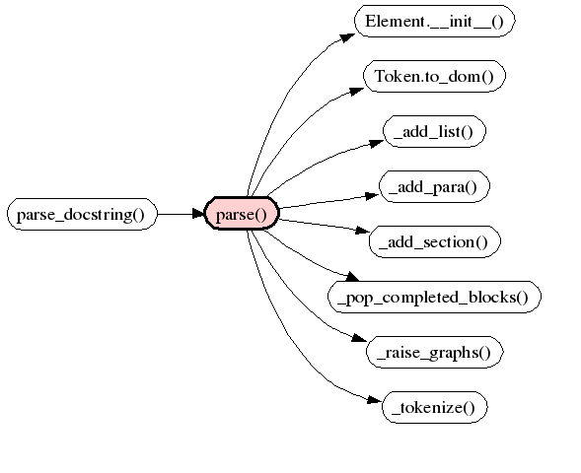

Network representation
NOTE
A directed graph has edges that point from one node to another.
Notes:
call graph: directed

Slide 19
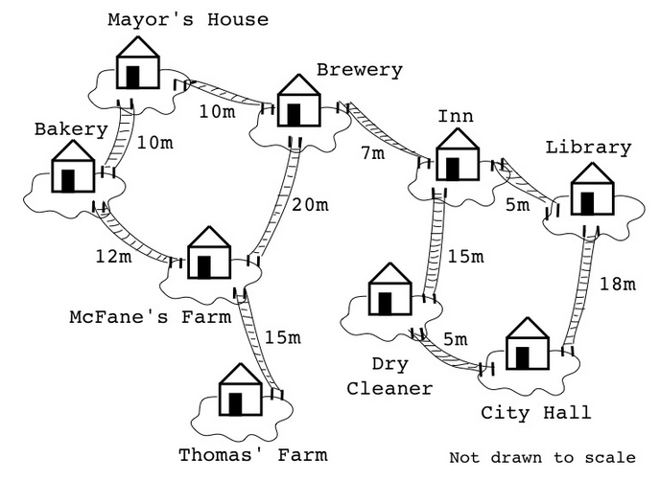
Network representation
NOTE
A weighted graph contains edges associated with real-valued numbers, e.g., to measure distance or importance.

Slide 20
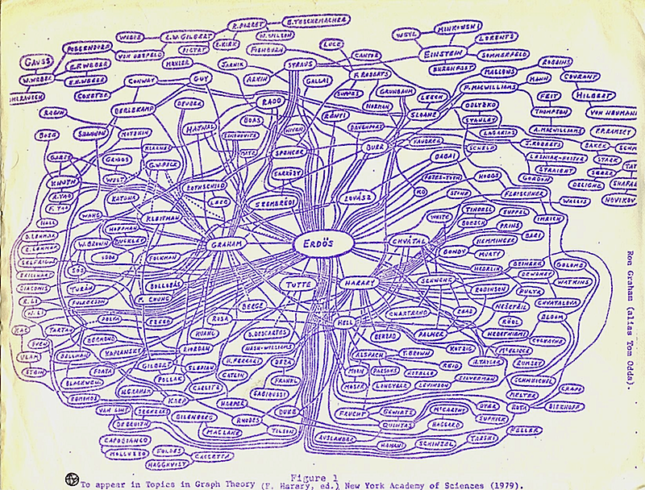
Network representation

Slide 21
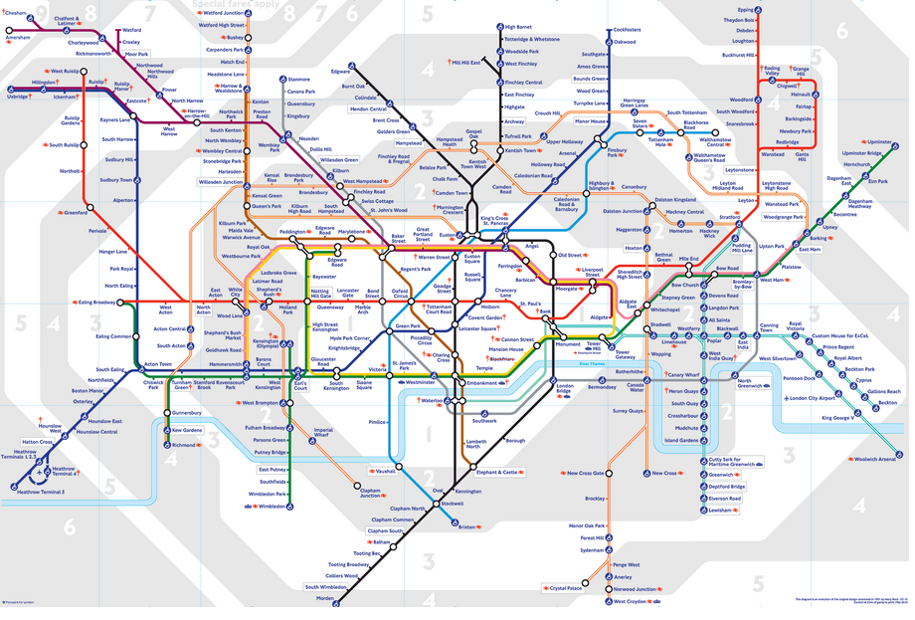
Network representation
Notes:
Q: how could you make this a weighted graph?
Note: a lot of network flow techniques are borrowed from (well-studied) problems arising from transportation networks

Slide 22
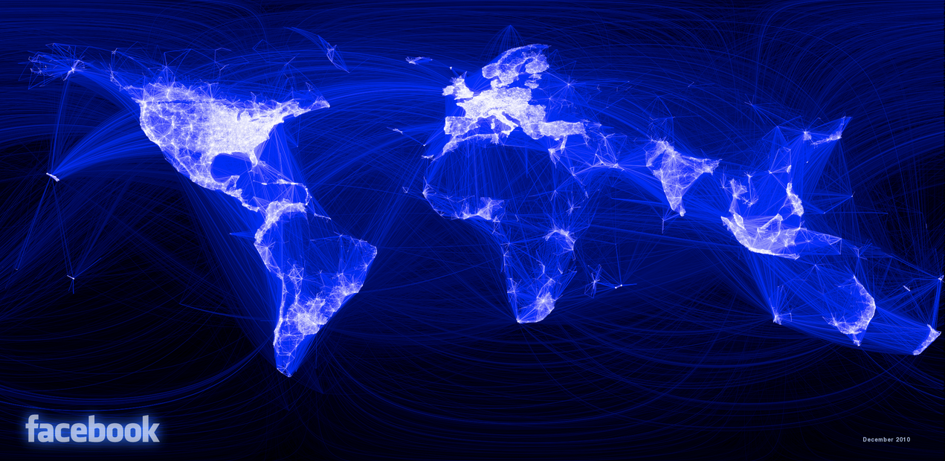
Network representation
Notes:
q: how could you make this a weighted graph?

Slide 23
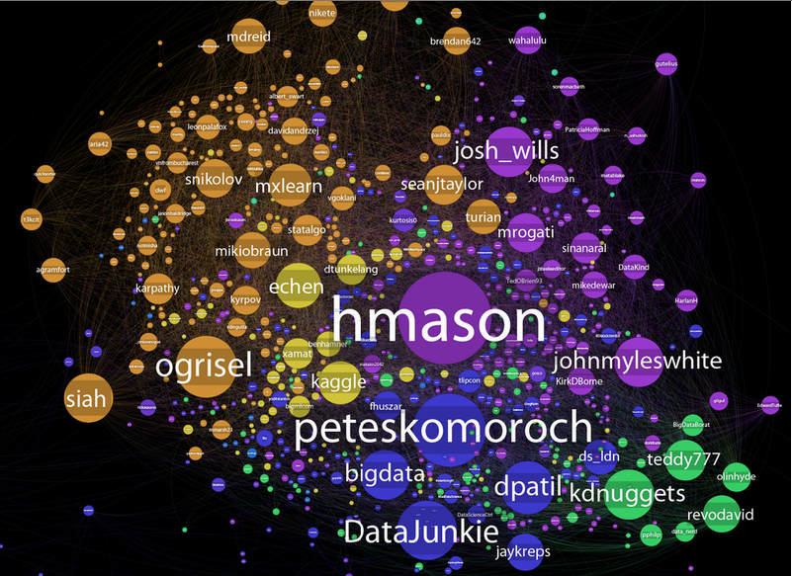
Network representation
Notes:
Q:

Slide 24
Network representation
In practical terms, we need some data structures to represent and manipulate our network data.

Slide 25
Network representation
In practical terms, we need some data structures to represent and manipulate our network data.
One common graph representation is the adjacency matrix. An n-node undirected graph can be represented by a symmetric n x n adjacency matrix A whose nonzero off-diagonal entries A_{ij} represent an edge between nodes i and j.

Slide 26
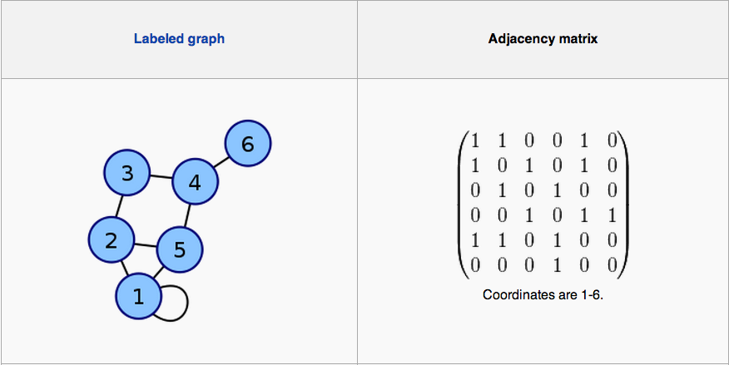
Network representation
Notes:
note: self-connected node, represented by diagonal entry in A

Slide 27
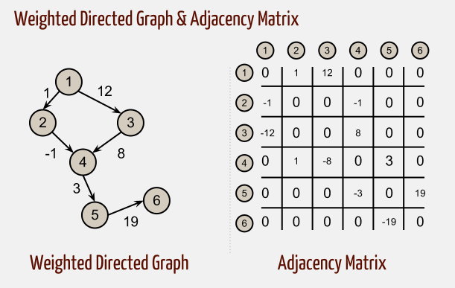
Network representation
NOTE
A directed graph has an asymmetric adjacency matrix.
Can you see why?
Notes:
Weighted graph → A not symmetric
Note: Positive entries represent (from, to) relationships

Slide 28
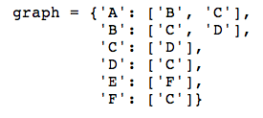
Network representation
Another useful tool is the adjacency list. The dict here is related:
Does this adjacency dict represent a directed or undirected graph? How could you generalize this to represent a weighted graph?
Notes:
Note: networkx uses dict-of-dicts repn to capture these types of relationships

Slide 29
Ii. network statics
INTRO TO DATA SCIENCE

Slide 30
Network statics
One key concept in the study of network structure is centrality. The centrality of a node is a measure of its importance in the network.

Slide 31
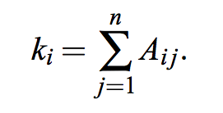
Network statics
One key concept in the study of network structure is centrality. The centrality of a node is a measure of its importance in the network.
The simplest centrality measure is the degree of a node, which is simply the number of edges connected to it. Using the adjacency matrix notation for an undirected graph, we can express the degree k_{i} of node i as:
Notes:
Can be decomposed into in degree & out degree

Slide 32
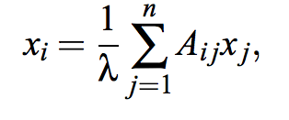
Network statics
A more sophisticated measure called eigenvector centrality allows important edges to give larger contributions to centrality:
Notes:
Note: X is an eigenvector of the adj matrix A with egval lambda!
Note: pagerank relies on a variant of this measure

Slide 33
Network statics
A more sophisticated measure called eigenvector centrality allows important edges to give larger contributions to centrality:
Here the eigenvector centrality x_{i} of node i is proportional to the average centrality of i’s network neighbors.
Notes:
Note: X is an eigenvector of the adj matrix A with egval lambda!
Note: pagerank relies on a variant of this measure

Slide 34
Network statics
A more sophisticated measure called eigenvector centrality allows important edges to give larger contributions to centrality:
Here the eigenvector centrality x_{i} of node i is proportional to the average centrality of i’s network neighbors.
NOTE
To see where the name eigenvector centrality comes from, try to imagine this relation expressed in vector notation!
Notes:
Note: X is an eigenvector of the adj matrix A with egval lambda!
Note: pagerank relies on a variant of this measure

Slide 35
Network statics
Another useful centrality measure is based on the idea of shortest-distance (or geodesic) paths through the graph.
Notes:
→ fraction of geodesic paths through the graph that hit node v

Slide 36
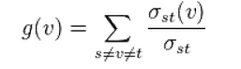
Network statics
Another useful centrality measure is based on the idea of shortest-distance (or geodesic) paths through the graph.
If σ_{st} is the number of geodesic paths from node s to node t, and σ_{st}(v) is the number of these paths that cross node v, then the betweenness centrality of node v is given by:

Slide 37
Network statics
Another useful centrality measure is based on the idea of shortest-distance (or geodesic) paths through the graph.
If σ_{st} is the number of geodesic paths from node s to node t, and σ_{st}(v) is the number of these paths that cross node v, then the betweenness centrality of node v is given by:
NOTE
Betweenness centrality measures the proportion of geodesic paths passing through a node.
This gives an idea of the node’s influence in the network.

Slide 38
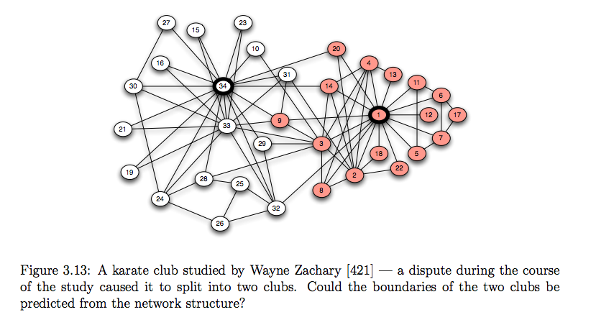
Application of betweenness
Notes:
Clustering via betweenness centrality

Slide 39
Network statics
Geodesic paths form the basis of another well-known property of networks called the small-world effect.

Slide 40
Network statics
Geodesic paths form the basis of another well-known property of networks called the small-world effect.
Specifically, most networks have a mean geodesic distance between nodes that is small compared to the network size as a whole.

Slide 41
Network statics
Geodesic paths form the basis of another well-known property of networks called the small-world effect.
Specifically, most networks have a mean geodesic distance between nodes that is small compared to the network size as a whole.
A famous study in the 1960s asked participants to try to get a letter to a particular individual by passing it from one acquaintance to another, and found that the mean geodesic distance in this case was about 6.

Slide 42
Network statics
Geodesic paths form the basis of another well-known property of networks called the small-world effect.
Specifically, most networks have a mean geodesic distance between nodes that is small compared to the network size as a whole.
A famous study in the 1960s asked participants to try to get a letter to a particular individual by passing it from one acquaintance to another, and found that the mean geodesic distance in this case was about 6.
NOTE
This is where the phrase “six degrees of separation” comes from.

Slide 43
IiI. network dynamics
INTRO TO DATA SCIENCE

Slide 44
Network dynamics
Suppose we’re interested in the idea of how information (or behavior) spreads through a network:

Slide 45
Network dynamics
Suppose we’re interested in the idea of how information (or behavior) spreads through a network:
- How do members of a social network influence each other to adopt
a new technology/product/behavior?
- How did information about the bin Laden raid spread over
Twitter?
- What’s the best way to use a social network to market your
product?

Slide 46
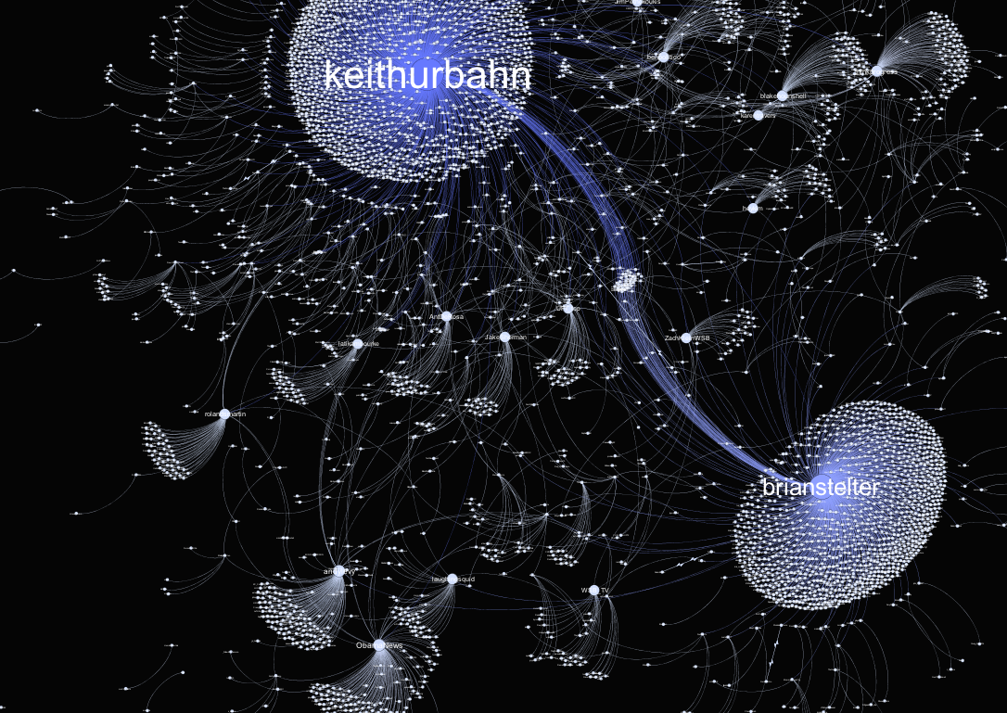
Network dynamics
Notes:
UBL twitter propagation network

Slide 47
Network dynamics
There are two primary methods of influence in social networks:
Notes:
Note – info effects = google glass
Direct benefit effects = free phone-to-phone messaging

Slide 48
Network dynamics
There are two primary methods of influence in social networks:
informational effects – people observe the decisions of their network
neighbors & gain indirect information that lead them to try the innovation themselves
Notes:
Note – info effects = google glass
Direct benefit effects = free phone-to-phone messaging

Slide 49
Network dynamics
There are two primary methods of influence in social networks:
informational effects – people observe the decisions of their network
neighbors & gain indirect information that lead them to try the innovation themselves
direct benefit effects – people may have incentives to use the same products/technology/etc. as their network neighbors
Notes:
Note – info effects = google glass
Direct benefit effects = free phone-to-phone messaging

Slide 50
Network dynamics
Studies of informational effects have shown that while initial lack of information makes innovations risky to adopt, adopters ultimately benefit.
Furthermore, early adopters share certain common traits (e.g., higher socio-economic status, wider travel experience), and they influence their neighbors by providing indirect information about the innovation.
Notes:
Note – info effects = Drs adopting new drugs
Direct benefit effects = adopting new forms of communication, eg telephone, email, etc

Slide 51
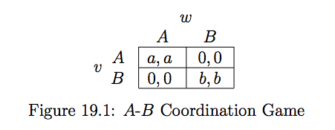
Network dynamics
Consider the following model of information diffusion for two nodes v, w and two behaviors A, B (with payoffs a, b):
The question we’d like to answer is, how can v maximize its payoff given that some of its neighbors adopt A & some adopt B?
Notes:
Strategic decision → game theoretic formulation

Slide 52
Network dynamics
To start modeling this problem, suppose first that the proportion of v’s neighbors selecting A is p, and the proportion selecting B is (1-p).
Notes:
Strategic decision → game theoretic formulation

Slide 53
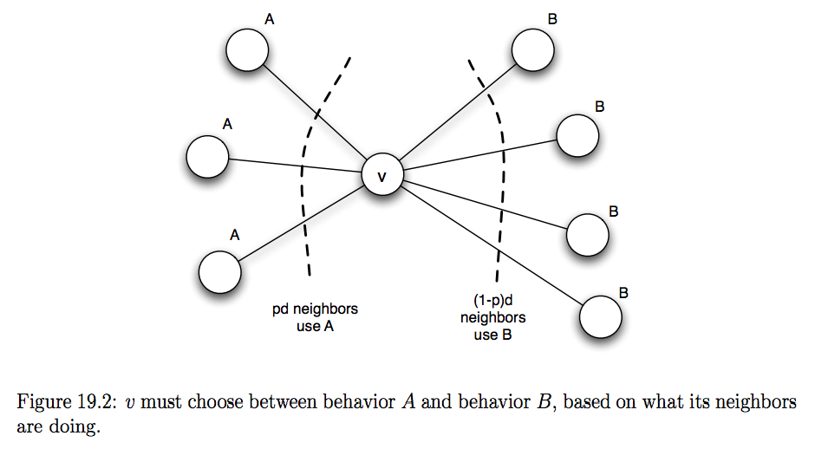
Network dynamics

Slide 54
Network dynamics
To start modeling this problem, suppose first that the proportion of v’s neighbors selecting A is p, and the proportion selecting B is (1-p).
Therefore the payoff to v for choosing A is pda, and the payoff for choosing B is (1-p)db.
Notes:
Strategic decision → game theoretic formulation

Slide 55
Network dynamics
To start modeling this problem, suppose first that the proportion of v’s neighbors selecting A is p, and the proportion selecting B is (1-p).
Therefore the payoff to v for choosing A is pda, and the payoff for choosing B is (1-p)db.
And thus v will adopt A if p (meets or) exceeds a threshold q:
pda ≥ (1-p)db ←→ p ≥ b/(a+b) = q
Notes:
Strategic decision → game theoretic formulation

Slide 56
Network dynamics
Adoption depends not only on the relative payoffs, but also on the structure of the network (eg, how many neighbors v has, and which particular nodes these neighbors are).
Notes:
Uses ideas from prev section

Slide 57
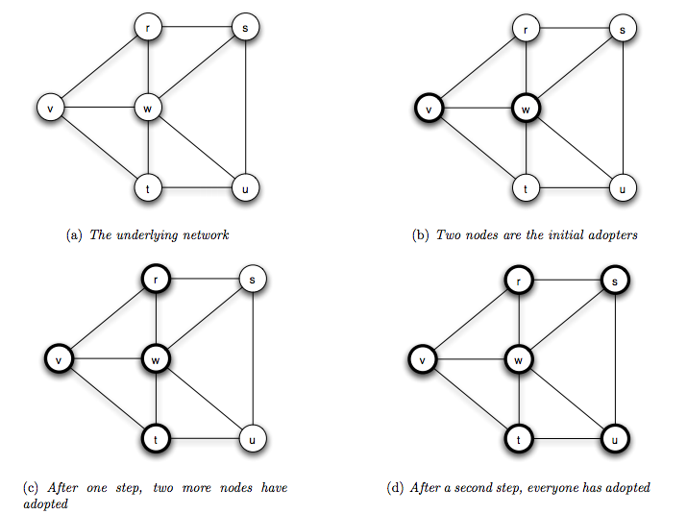
Network dynamics
NOTE
Since all nodes have adopted, this is called a complete cascade (at threshold q).

Slide 58
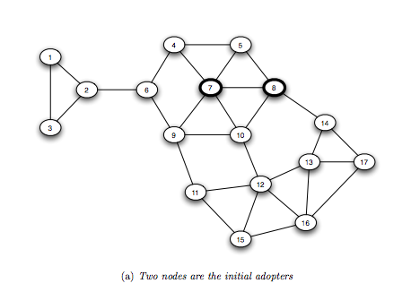
Network dynamics
Consider the same diffusion now on another graph.
Notes:
All nodes adopt → complete cascade

Slide 59
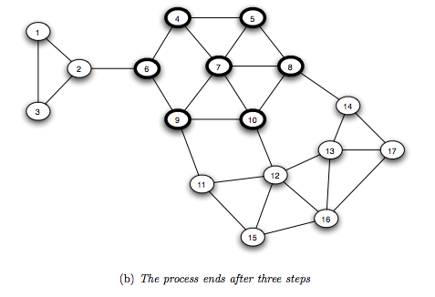
Network dynamics
Since not all nodes adopt, this is called a partial cascade.

Slide 60
Network dynamics
Here’s an interesting question: how can you identify which (non-adopting) nodes are most important to allowing the cascade to continue?

Slide 61
Network dynamics
Here’s an interesting question: how can you identify which (non-adopting) nodes are most important to allowing the cascade to continue?
Answering this question effectively is the idea behind viral marketing.

